Slide 1
Math interviews
Made by: JT Long

Slide 2
Aunt Jan
My Aunt Jan is a manager of a company that provides other company's with computer support. She trains people that are going to be trainers. She works with people all over the world like in the Phiilippines. She went to University of Iowa and she graduated in 1991. She worked in public relations and got a job at MCI. MCI is a call center business. She worked her way from the bottom all the way up to leadership. 5 years later she went and worked at Stefanini, the place she works at now. Aunt Jan has had different roles and whenever she can work with trainers all the time, she would convince her boss to let her have it because she liked it so much. Aunt Jan has had the job she works at now for 4 years and she said it was really hard to earn.

Slide 3
Criteria 2- Aunt Jan
Aunt Jan has employees in the Philipines. So she needs to figure out how many pesos equal one US dollar. She works with the company's budget, and she figures out how to bring money into the company, or she figures out where and how to spend the company's money. She needs to figure out how much to pay employees annually. That means every month, or year. Aunt Jan has to figure out how much employees hourly wage (their hourly payment). The Philipines are islands just outside of China. They are sort of a divider between the South China Sea and the Philippine sea.

Slide 4
Criteria 3 – Aunt Jan
One of the ways the math in my aunt's job is important is that it is important to figure out how much US dollars equals, for example 273 English pounds. You wouldn't want to send US $451 to someone in Germany. Would you? It is also very important to send the right amount of money to the employees, so they can keep living. Another thing about that, if you don't pay them what they deserve, they may quit on you. Math is used in simple ways too, like figuring out what time it is in another country, before you call them on a super important meeting. I think a lot of people would not like being called at 5:00 AM, for a meeting they didn't know about. My aunt has a very important job, and her math is very important.

Slide 5
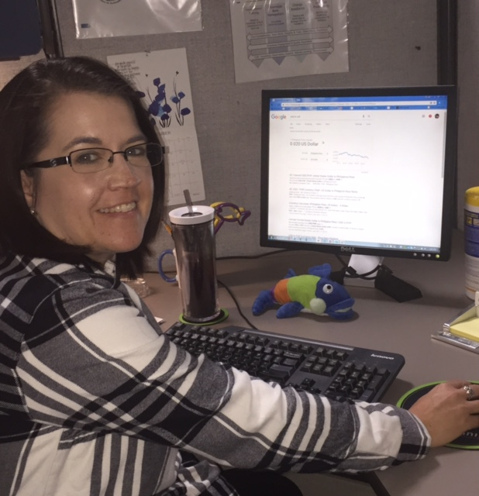
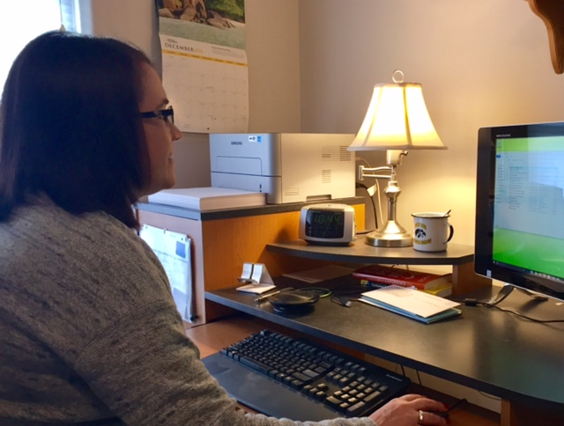

Slide 6
Uncle Jeff
My uncle teaches high school students. He teaches mostly technology classes. He teaches everything from basic tech like Excel, to programming in 3 languages! Uncle Jeff teaches Java Script, C++, and Basic, those are languages in programming. Last, but not least, he teaches web page design. Web page design is a collection of electronic files that determine the colors, textures, text styles, graphics, and images. It is designing the pages of your website, and it is what your web users see. I personally think that web page design is very hard to master, but I have a good feeling that Uncle Jeff is very good at it! :-)

Slide 7
Criteria 2- Uncle Jeff
In class, Uncle Jeff is teaching Microsoft Excel, and how to calculate math problems by entering equations. The students need to know that they entered the right equation. The students need to know that they did the math and entered the equation right. So they get the answer they expected from excel. The students computer knowledge comes from algebra for logic. Computer programming is based on problem solving. While it could not be math, the knowledge for how to solve the problem is based off of logic they learned in algebra. Sometimes in class they do harder calculations.

Slide 8
Criteria 3 – Uncle jeff
It is important to know how to solve problems, because life is full of story problems. They need to be done both mathematically and in general. The problems students learn in school can help in life. Maybe they grow up to be somebody who works on computers. Then they already have experience about computers. There are so many new computers, and we need people to handle them. Maybe the software was updated, and somebody needs help setting their device up. We need people to do that. I think my uncle's job is very important to everybody.

Slide 9
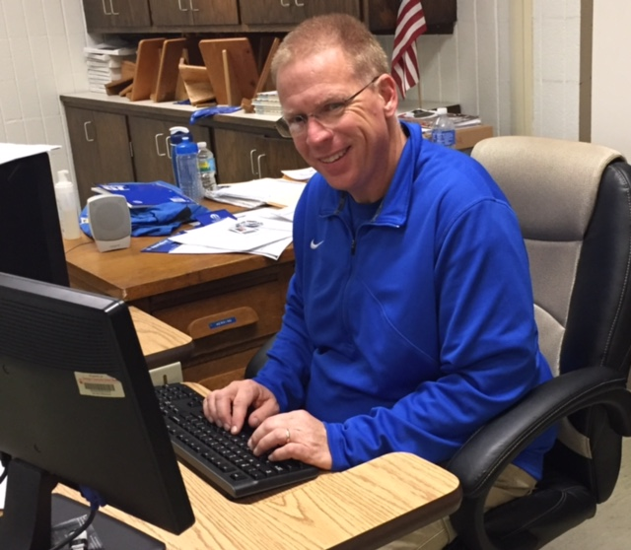
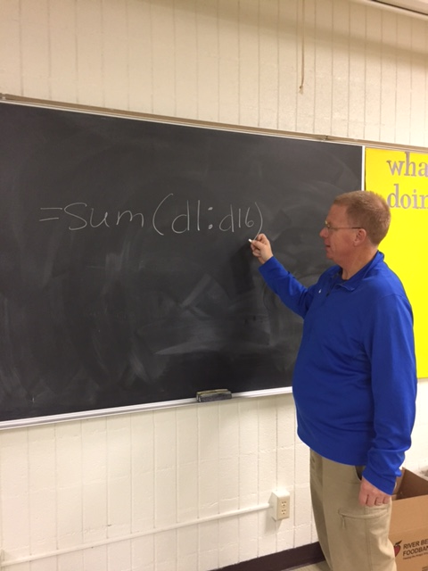

Slide 10
John spargo
John spargo is a Macintosh computer consultant. He consults and provides physical, and software service. John does setup of new or used computers, including the software installation. He does technical support for people that are having trouble with their older computers. John consults with people for advice on what Macintosh, (Mac), they should get. That includes how much space they need, and other specifications. He had a real advantage because before he started his consulting company, he was the general manager of a store in Cedar Rapids called North Bay Computerware. He started his Mac consulting company in 1993 that he has worked at ever since, and in 4 to 5 months, John was very profitable, which was very impressive.

Slide 11
John Spargo- Criteria 2
John uses a program called Filemaker Pro to send bills/ invoices to people so they will pay him. He uses a spreadsheet program to see who has paid him and who hasn't. John is a great example for problem solving. He needs to know problem solving and critical thinking because he fixes computers. When people consult with him he might need to figure out if the computer's problems are physical, or in the software. Something that really helped him was that he was a math and physics teacher. So if he asks a group of people a question, and you're the only one that got it right, you must be pretty smart. John's job uses math all the time and it is pretty important.

Slide 12
John spargo- Criteria 3
John uses so much math that is so important. His math has an economic effect on his community. He bills his customers, and they pay him accordingly. Then he goes back into his community and spends it in stores. When he taught as a math teacher, he taught rational analysis and thinking because the world needs more people that are capable of that. John has various investments. The banks send him portfolio investments. When he gets those, he needs to be able to read the statements. When he was a math teacher, he taught how to be able to read those so people aren't clueless when they get them.

Slide 13
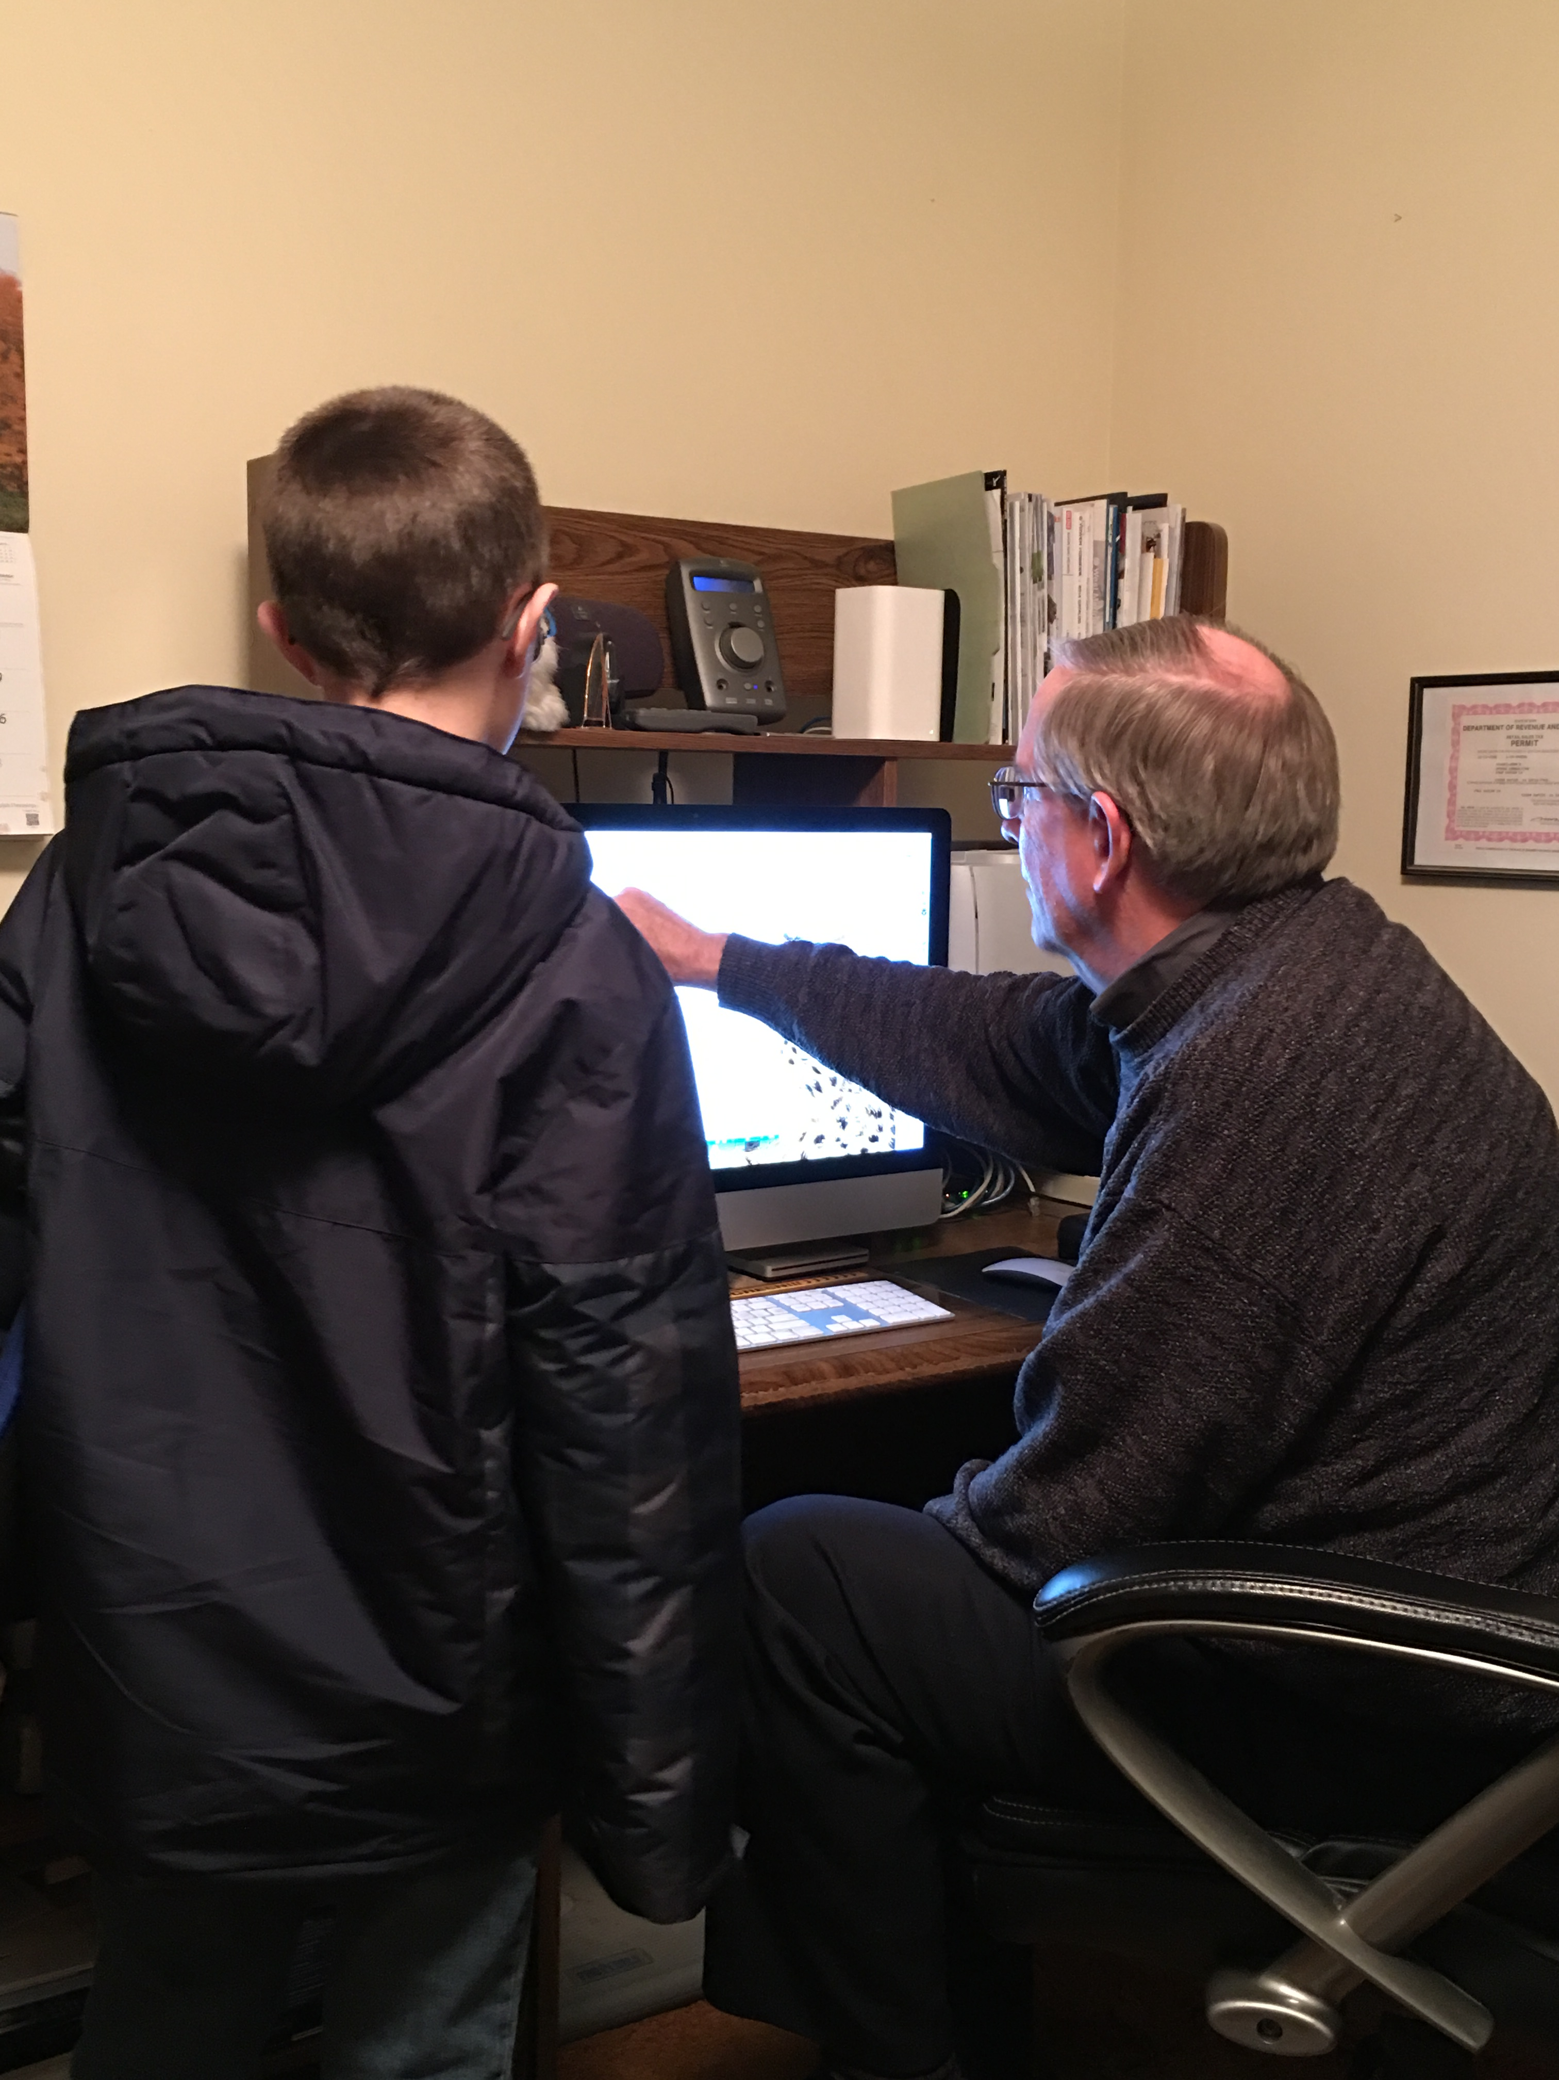
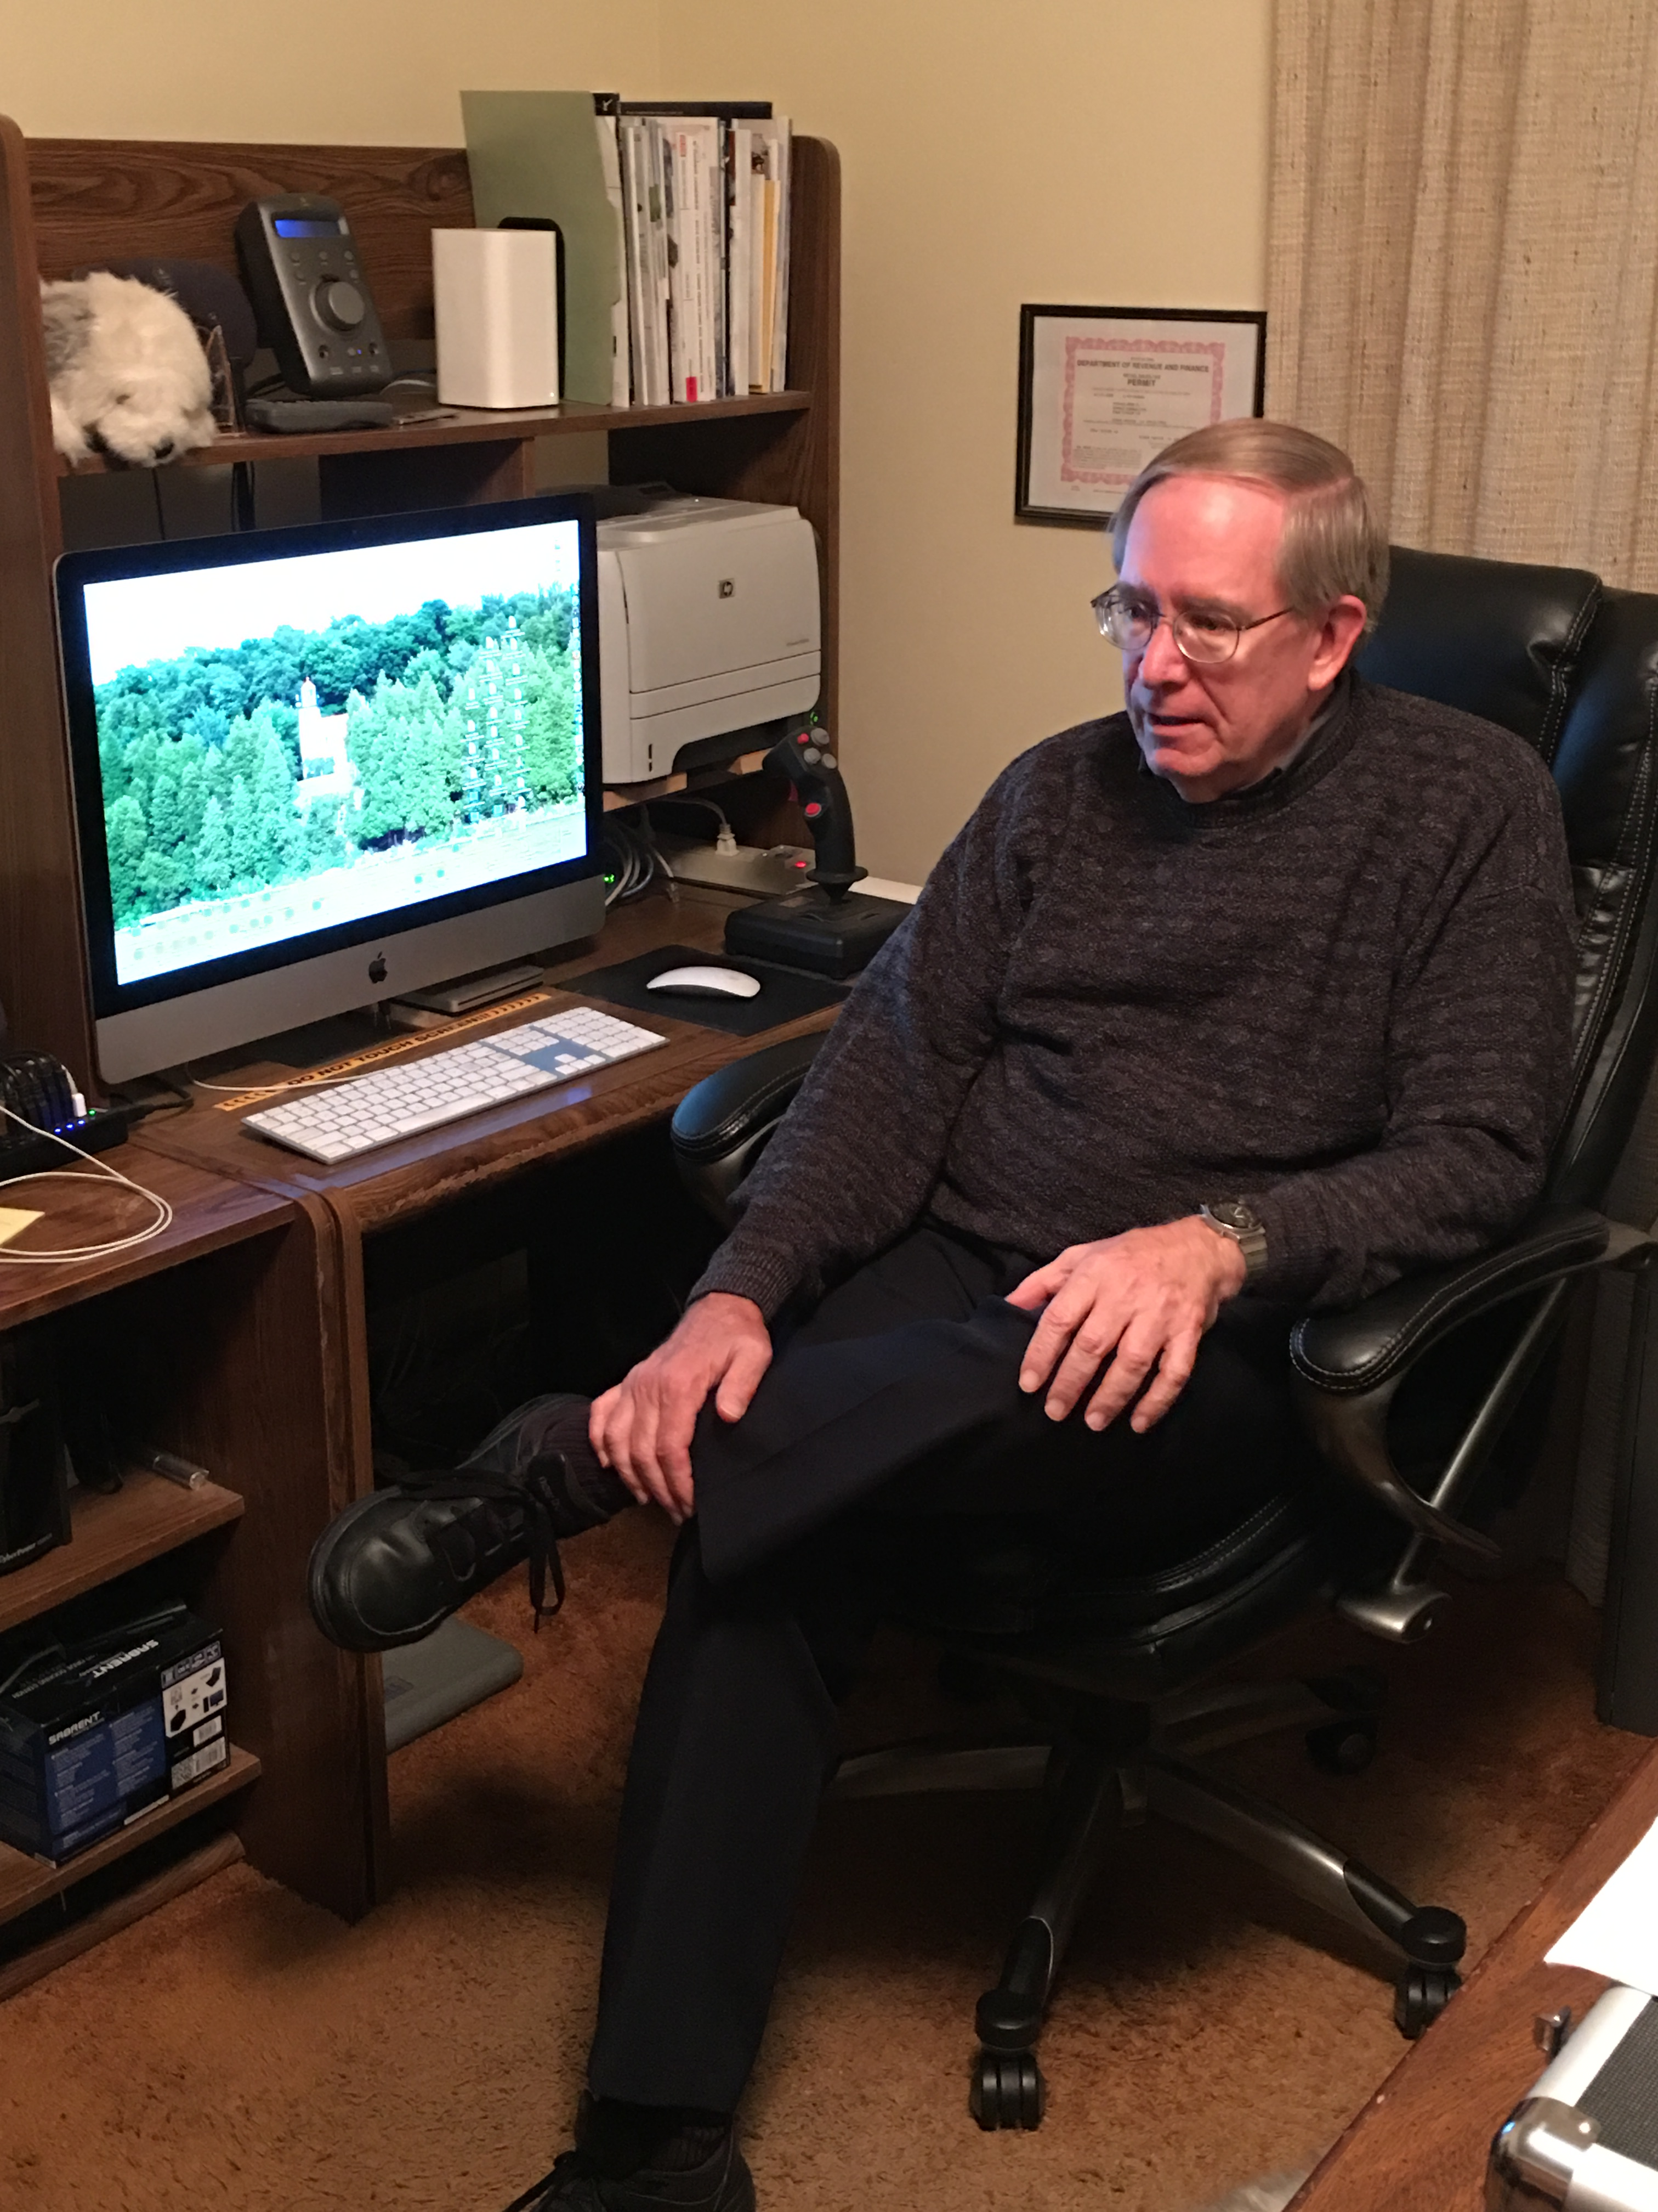
"Say you draw a line on a glass. Then you fill water up to that line, and drop an ice cube in, what happens? Then you draw another line that's higher and drop another ice cube in, what happens? Does the water level get higher, lower or stays the same?"- John Spargo

Slide 14
My Dad
My dad is an IT director. IT stands for information technology. He designs computer systems and systems that run applications for Syncreon's business. Since he is a director, my dad manages other people that create computer systems as well. My dad works at a company called Syncreon, which I believe is located in the Oakland Technology Park. Syncreon is a logistics company, and logistics means the process of planning and coordinating a business process. Syncreon runs large warehouses as a logistics company. Logistics can be a simple thing like moving boxes. He works in large datacenters, that store data in them. Finally my dad tries to reduce latency. Latency is the time you have to wait to send something over the internet, and have it get back to you. But that seems near impossible with how fast computers are now.

Slide 15
My dad -Criteria 2
My dad uses math on a daily basis in a couple of different ways. He has money budgets. He uses math to calculate those budgets. My dad uses math to figure out how much money he has, has spent, can spend, and most importantly, how much money he needs to ask for in the next year. The second way he uses math is since Syncreon is a global company, he needs to figure out what time it is over in Germany before he calls at 5 in the morning. My dad needs to know where he is in the world and where the person he wants to call is in the world. But most importantly he needs to know how many hours ahead or behind, say Germany, is to Michigan and their local time. Or vise versa.

Slide 16
My dad- Criteria 3
A reporter asks " So Jon Long, how is your math important in the world?" My dad says: " Well, it is important because trying to reduce latency means a lot of good things." "Like what" the reporter asks. My dad replies by telling him: " Well first off, it means faster computers. Secondly it means more productivity and less frustration. Lastly it means faster internet." " Wow, that's- that's great. So, how else is your math important?" " Well another thing is that people who know how to manage budgets means more great things." " like what?" " They won't get into debt as much and will live happier lives." " Thank you for your time" the reporter says, and walks away.

Slide 17
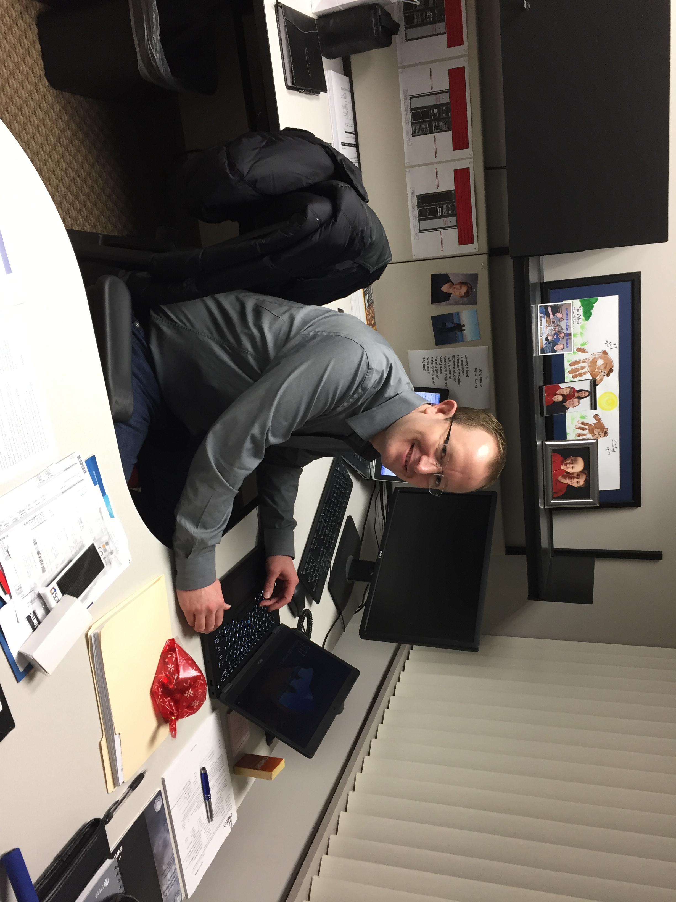
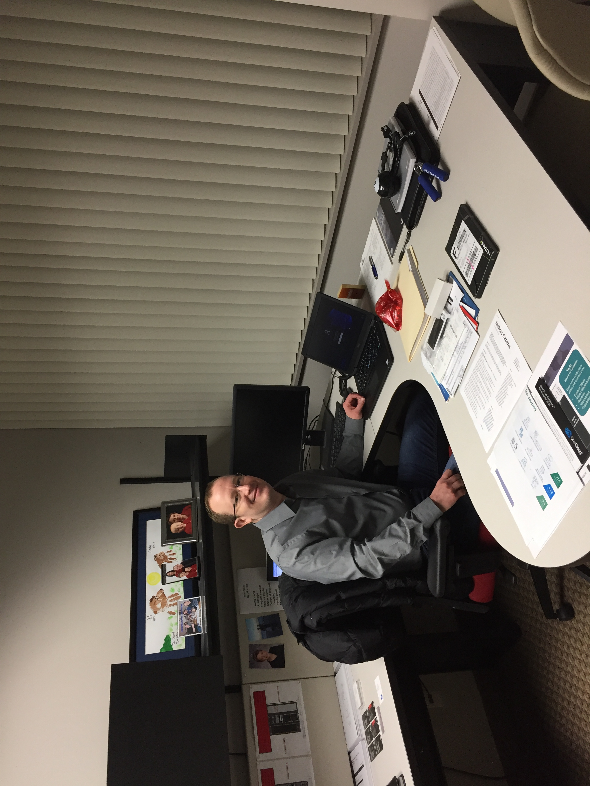

Slide 18
Mr. Stencel
Have you ever been on the highway and passed a big building that says "Delfi"? Well, that's where Mr. Stencel works. Delfi is an automotive company. Mr. Stencel's background is an electrical engineer and has been in sales for 20 years. At Delfi he is a sales account manager. He went to University of Detroit in an engineering program. It was a 5 year program that included 1 year of co-op working related to studies. It was very challenging to get his engineering degree. His biggest challenge was the level of mathematics required in the program. He is also the owner of Pro Martial Arts karate studio.

Slide 19
Mr. Stencel – Criteria 2
You might say that he should be doing more complicated math. But in fact, that is the opposite. He uses the basic computation on an everyday basis. A lot of that is calculating percentages and future type numbers. Sometimes he uses statistical analysis. Statistical analysis is another type of math. He uses business analysis or a counting type of math for balance sheets. Mr. Stencel uses those calculations to put together business proposals, to send to his customers. Then they come back and say that the prices are too high. Then the negotiation process starts. If he ultimately has the best business package, they get the business.

Slide 20
Mr. Stencel – Criteria 3
Mr. Stencel arrives at the Detroit International Airport. He takes his bags through security. A security guard at the gate asks him a few questions. "Sir, do you use math, and if so how is it important?" " Well, when I go to the store I need to be able to know if I am getting a good sale." The man writes this all down. " I think that math is everywhere in the world." " Write now I am on my way to Europe. When I packed I checked the weather radar to see how cold it was over there. If it was zero degrees over there, I took that and figured out it was 15 degrees over here." "Did any of that help you?" The man murmurs what he had just written over to himself. " Yes, that helped me quite a lot. Thank you." The man went to get in the pre-board line.

Slide 21
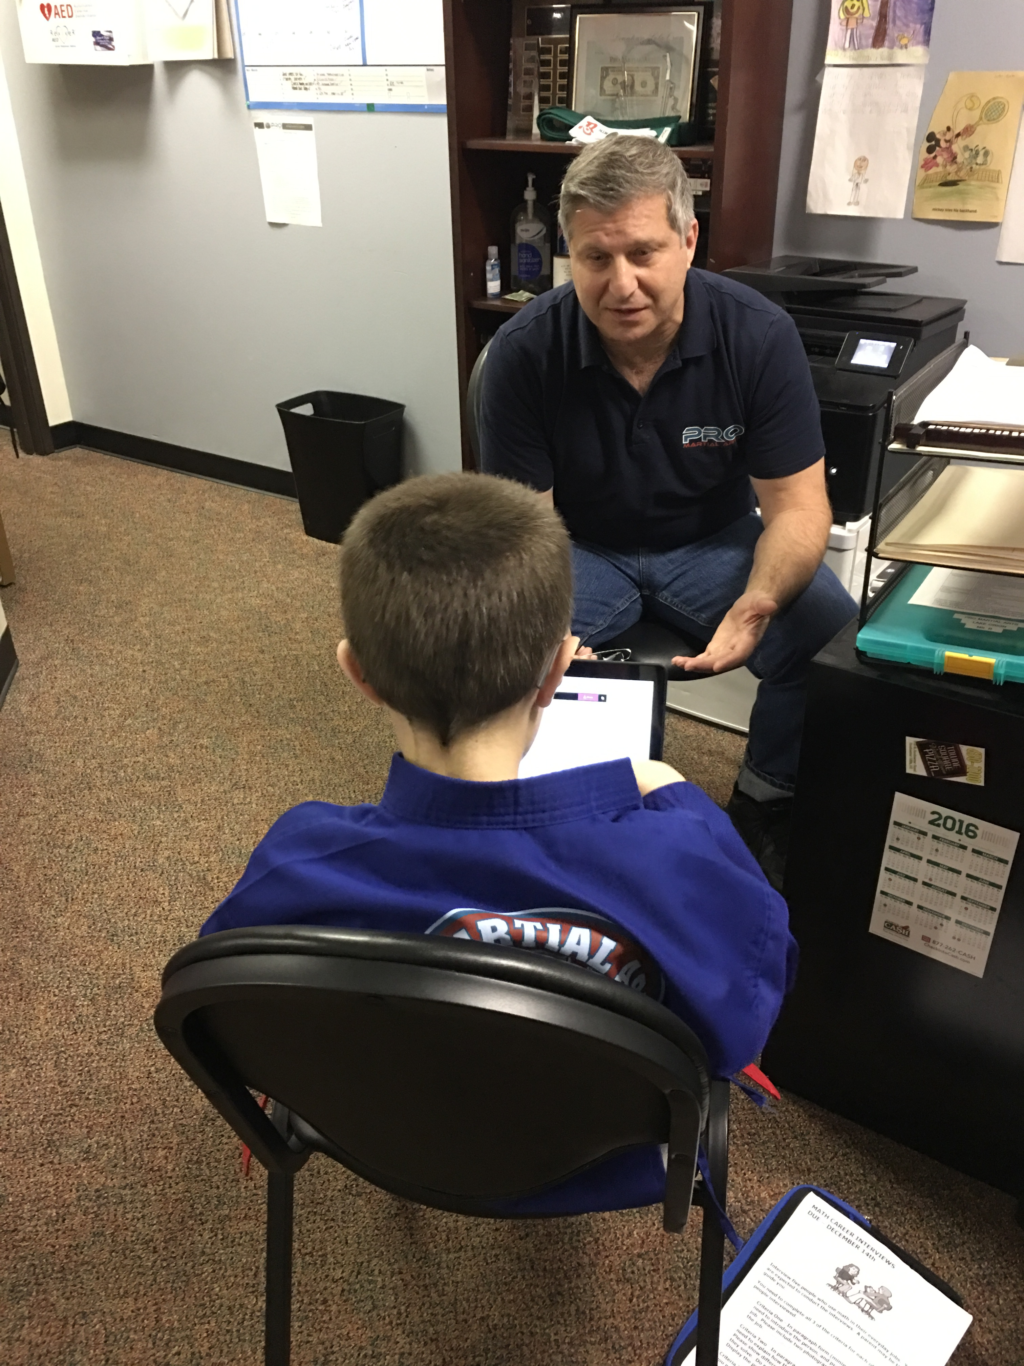
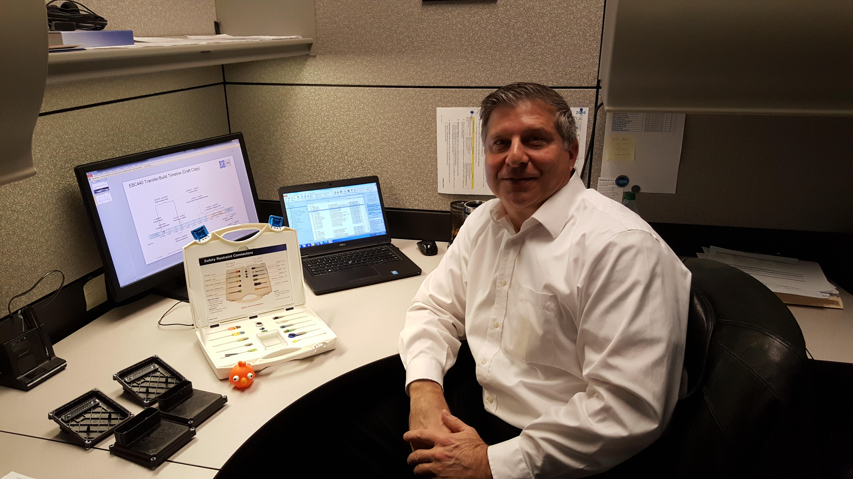
THE END

